Slide 1
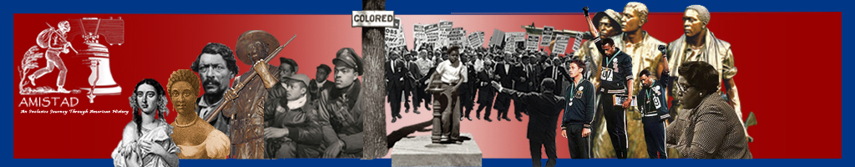
Web-Based Curriculum
I-It and I-You Relationships in
Martin Luther King. Jr.’s
Letter From Birmingham Jail
New Jersey Amistad Commission
Notes:
Dr. Martin Luther King Jr. wrote the Letter from Birmingham Jail after he was arrested for participating in a non-violent protest against the racial segregation Birmingham's city government allowed

Slide 2





Martin Luther King Used Martin Buber:
Martin Buber was a modern philosopher known for his ideas about how people communicate and connect. He talked about two important types of relationships: the "I-You" relationship and the "I-It" relationship.
In an "I-You" relationship, people see each other as equals and treat each other with respect. This means they care about one another's feelings and experiences. On the other hand, in an "I-It" relationship, one person sees the other as less important, almost like an object. This kind of relationship can lead to misunderstandings and hurt feelings.
Notes:
Buber teaches that segregation relegates Black human beings out of humanity and into the realm of a thing.

Slide 3
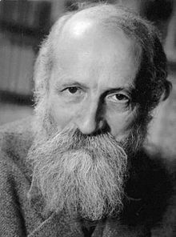
Buber's ideas remind us how important it is to treat each other with kindness and to recognize each person's value. By understanding these different types of relationships, we can work toward better communication and connection with others.

Slide 4
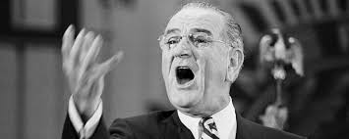
President Lyndon Baines Johnson
President Lyndon Johnson illustrated how some treated black people as nonhuman objects. Biographer Robert Caro writes, “When Johnson asked his chauffeur, Robert Parker, whether he’d prefer to be referred to by his name rather than ‘boy,’… or ‘chief.’ When Parker said he would rather Johnson use his name, Johnson grew angry and said, “As long as you are black, and you’re gonna be black till the day you die, no one’s gonna call you by your name. So no matter what you are called, … you just let it roll off your back like water, and you’ll make it. Just pretend you’re a piece of furniture.”
Notes:
President Lyndon Johnson was known to be rude and crude and regularly used racial emphatics. For example, Robert Parker revealed, “Whenever I was late, no matter what the reason, Johnson called me a lazy good-for-nothing n-word..“ Robert Cario shows that Johnson told Parker he should never expect Johnson to use his name. He would be called boy, chief, or the n-word. He then told him to act like a “piece of furniture,” an “it. This was an I-it relationship.

